Slide 1

IMPACT OF CAR FEATURES
TRAINITY ASSIGNMENT PRACHI SHINDE

Slide 2



CONTENT
PROJECT DESCRIPTION
APPROACH
TECH-STACK
INSIGHTS
RESULTS

Slide 3

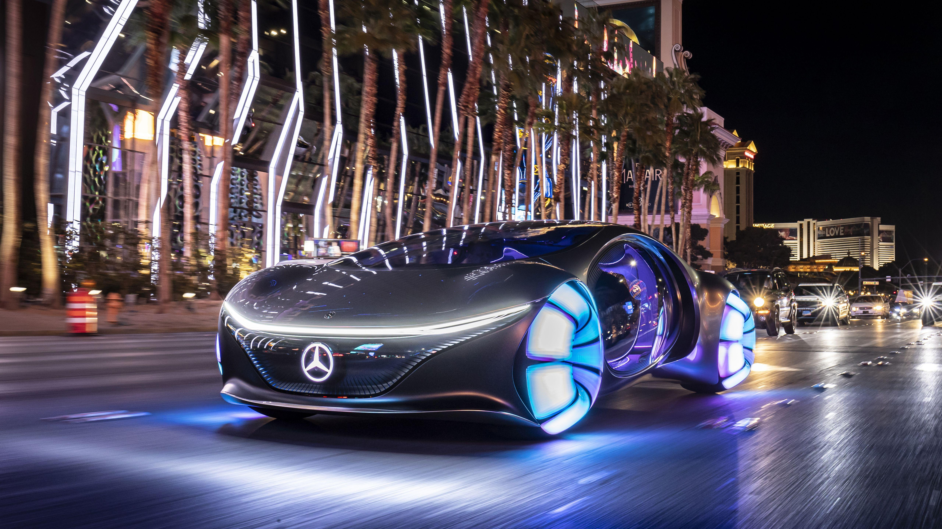
PROJECT DESCRIPTION
The project, Analyzing the Impact of Car Features on Price and Profitability, aims to uncover how various car specifications, such as engine power, fuel efficiency, market category, and popularity, influence pricing and profitability in the automotive industry. Using a dataset of over 11,000 car models, the analysis explores trends in features and pricing, identifies key determinants of a car’s MSRP, and examines consumer preferences. By leveraging advanced Excel techniques, including regression analysis and visualization tools, the project provides actionable insights to help manufacturers optimize pricing strategies and focus on high-demand, profitable features, ultimately enhancing competitiveness and meeting market needs.

Slide 4
project DESCRIPTION
Overview of the Project and Its Purpose: The project "Analyzing the Impact of Car Features on Price and Profitability" focuses on identifying key factors that influence car pricing and profitability in the automotive industry. With changing consumer preferences and technological advancements, this analysis aims to help car manufacturers optimize pricing strategies and product development to remain competitive and profitable.
Business Problem: The primary question addressed in this project is: How can car manufacturers optimize pricing and product development to maximize profitability while meeting consumer demand? The analysis seeks to uncover the relationships between car features (e.g., engine power, fuel efficiency, transmission type) and pricing to identify which features are most valued by consumers and contribute significantly to profitability.
Dataset Description: The dataset, titled “DATASET", includes 11,159 car models with specifications such as make, model, year, fuel type, engine power, transmission type, vehicle size, popularity, and MSRP. Collected by Cooper Union and last updated in 2017, this dataset provides a rich source of information for analyzing trends, features, and pricing in the automotive industry.

Slide 5
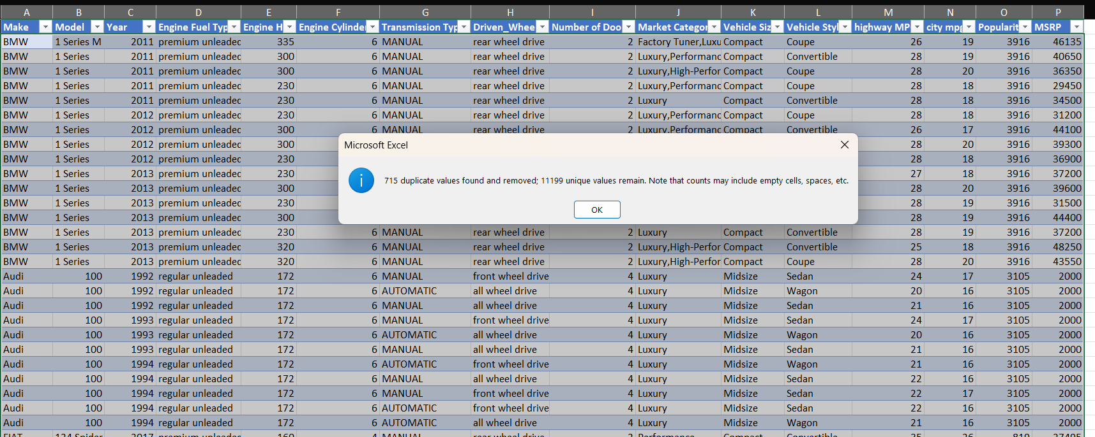
DATA CLEANING
STEP 1 : REMOVING DUPLICATES USING “REMOVE DUPLICATE” FUNCTION FROM DATA TAB

Slide 6
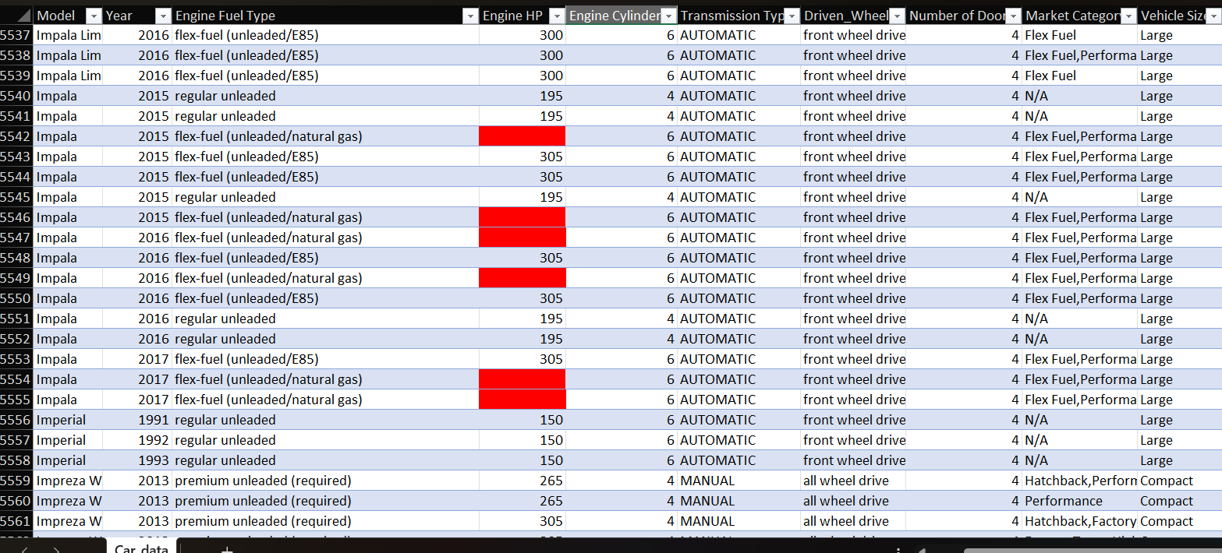
DATA CLEANING
HIGHLIGHTING AND HANDLING BLANK CELLS

Slide 7
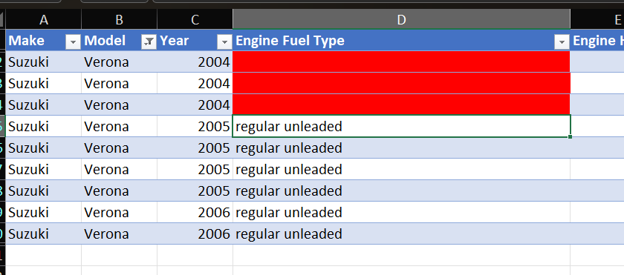
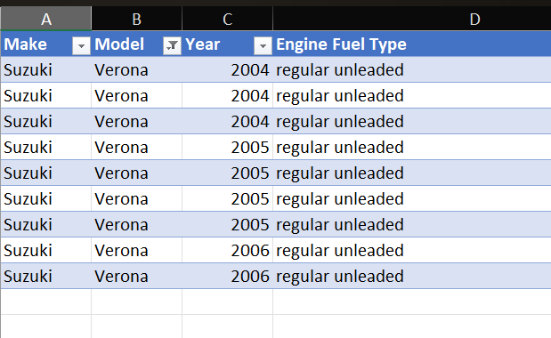
FOR BLANK VALUES IN “ENGINE FUEL TYPE” COLUMN WE COMPARED THE VALUES WITH OTHER ROWS IN COLUMN “MAKE”, “MODEL”, “YEAR”, AND “ENGINE HP” AND INPUTED THE VALUES MANUALLY.
FOR BLANKS VALUES IN “ENGINE FUEL TYPE” COLUMN FOR “SUZUKI VERONA” , “REGULAR UNLEADED VALUES WAS OBSERVED
IN OTHER ROWS, SO WE USED THAT TO FILL THE EMPTY CELLS.

Slide 8
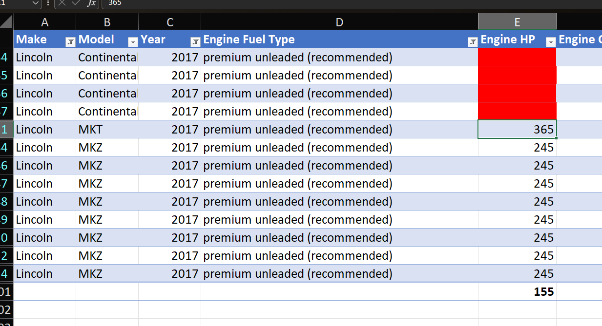
FOR BLANKS IN “EMGINE HP” COLUMN WE USED THE SAME STRATEGY AND COMPARED IT WITH OTHER ROWS OF SAME
CAR MODEL AND MAKE AND THEN USED THAT VALUES TO FILL THE BLANKS.
FOR LINCOLN CONTINENTAL WE OBSERVED THAT FOR ENGINE FUEL TYPE PREMIUM UNLEADED(RECOMMENDED)
AND 2017 YEAR MODEL, THE MOST COMMON ENGINE HP VALUE WAS 245 SO WE USED THAT VALUE.

Slide 9
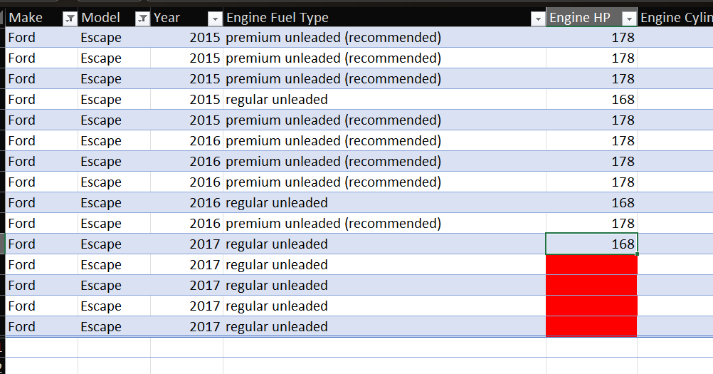
FOR FORD ESCAPE 2017 UNLEADED ONE ROW HAD THE VALUE OF 168 HP SO WE USED THE SAME VALUUE IN
OTHER ROWS AS WELL

Slide 10
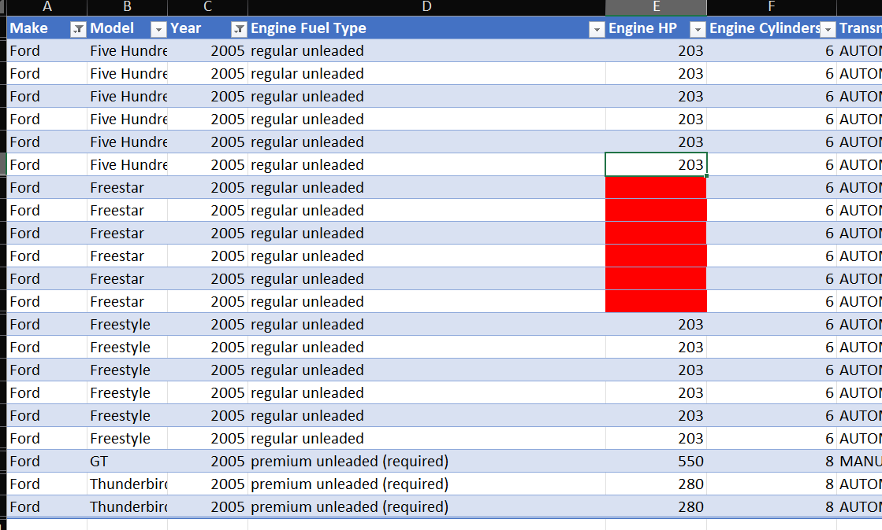
FOR FORD FREESTAR 2005, WE COMPARED OTHER CARS OF FORD IN 2005 AND OBSERVED THAT FOR 2005 REGULAR
UNLEADED ENGINE FUEL TYPE 203HP WAS THE HORSEPOWER SO WE USED THAT VALUE.

Slide 11
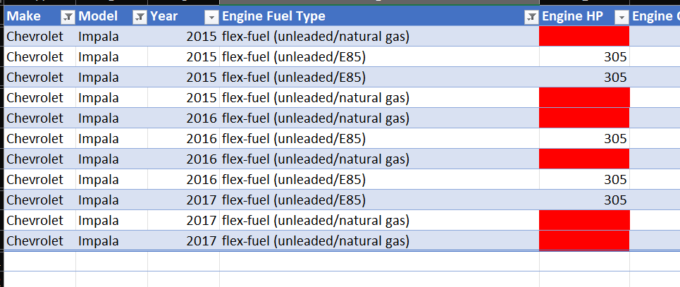
FOR CHEVROLET IMPALA WE OBSERVED THAT THE ENGINE HP FOR OTHER ROWS WAS 305 SO WE USED THAT VALUE

Slide 12
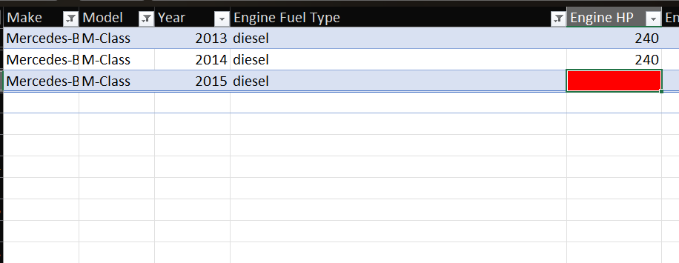
FOR MERCEDES-BENZ M-CLASS DIESEL ENGINE OTHER ROWS HAD 240 AS ENGINE HP VALUE SO WE USED THAT VALUE IN BLANKS.

Slide 13
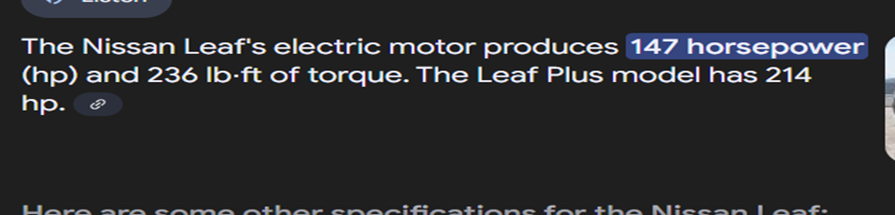
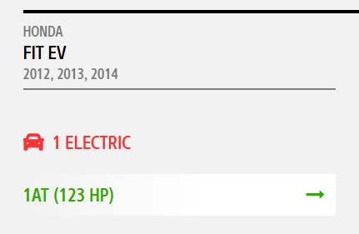
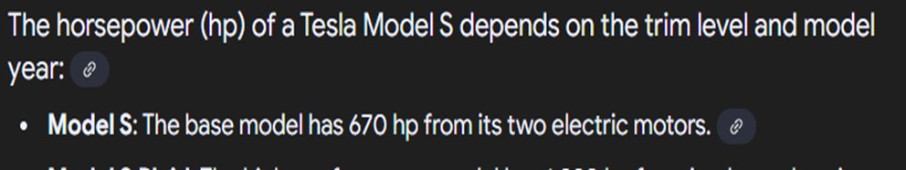
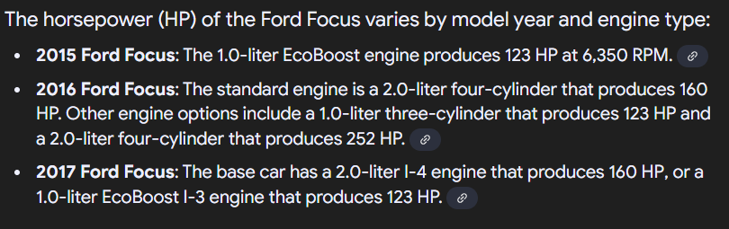
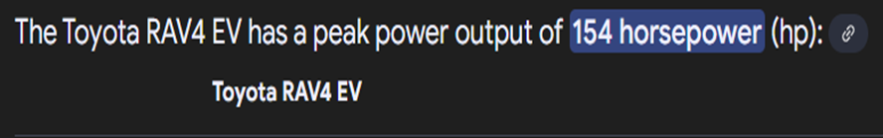
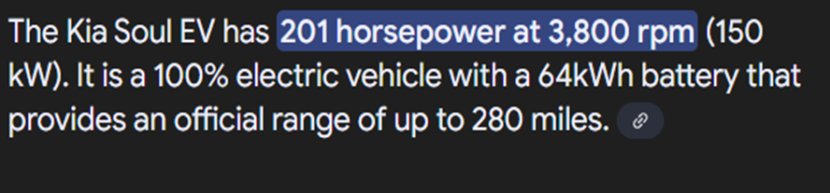
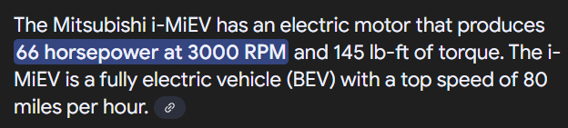
FOR ENGINE FULE TYPE ELECTRIC , WE WERE NOT ABLE TO USE THE SAME STRATEGY TO FIND OUT THE HP . SO WE SEARCHED FOR THEM ON INTERNET AND OBTAINED THE VALUES TO INPUT. OBTAINED VALUES ARE AS FOLLOWS:- FIAT 500E- 117HO HONDA FITEV- 123HP NISSAN LEAF- 147HP KIA SOUL EV-201HP FORD FOCUS 2015-123HP FORD FOCUS 2016-160HP TESLA MODEL S- 670HP FORD FOCUS 2017- 160HP MITSUBISHI I-MIEV – 66HP TOYOTA RAV4 EV-154HP

Slide 14
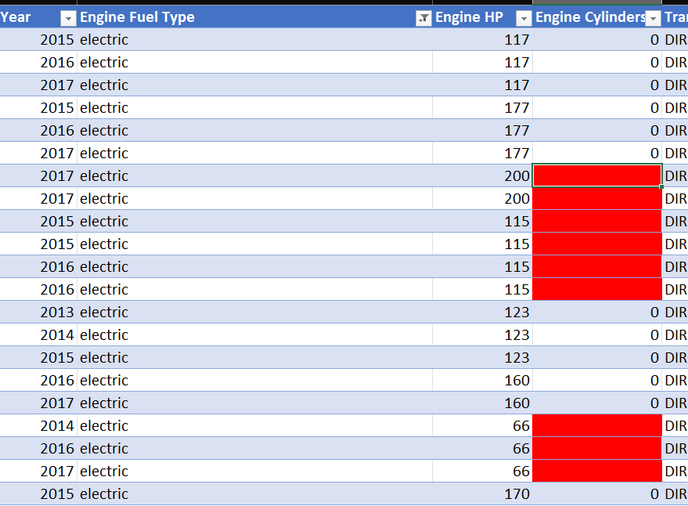

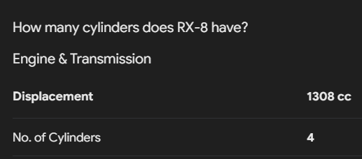
FOR BLANK VALUES IN ENGINE CYLINDER COLUMN ONLU TWO CAR MODELS MAZDA RX-7 AND MAZDA RX-8 ONLY HAD BLANK VALUES. WE SEARCHED FOR IT ONLINE AND OBTAINED THE ACCURATE VALUES AND USED THAT VALUES

Slide 15
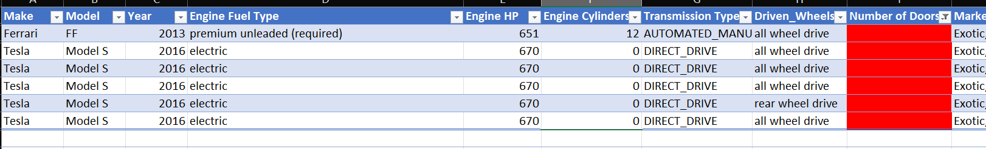
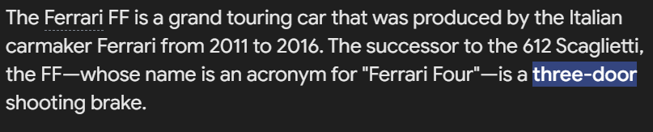
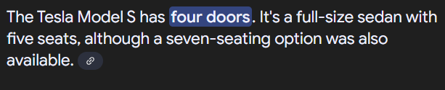
FOR BLANK VALUES IN NUMBER OF DOOR COLUMN WE USED THE INTERNET TO SEARCH FOR ACCURATE VALUES AND WE FOUND OUT THAT FOR FERRARI FF HAS 3 DOORS AND TESLA MODEL S HAS 4 DOORS.

Slide 16
APPROACH
Descriptive Statistics: Calculate summary metrics like mean, median, and standard deviation to understand the overall structure and characteristics of the dataset.
Exploratory Data Analysis (EDA): Use visual tools such as scatter plots, bar charts, and pivot tables to explore the relationships between variables and identify initial trends.
Correlation Analysis: Quantify the strength and direction of relationships between numerical variables (e.g., engine horsepower and MSRP).
Segment Analysis: Group and analyze data by categories like market type, brand, and body style to identify patterns in pricing, popularity, and profitability.
Regression Analysis: Develop regression models to determine which features have the strongest impact on car prices (MSRP) and calculate feature coefficients.
Data Visualization: Create detailed visual representations such as trendlines, stacked bar charts, and bubble charts to effectively communicate findings.
Trend Analysis: Analyze historical data trends, such as changes in MSRP and fuel efficiency over time, to identify market shifts and opportunities
.Predictive Modeling: Build models to predict MSRP based on car features and validate the accuracy of these predictions.
Interactive Dashboard Development: Use Excel tools like pivot tables, slicers, and combo charts to build an interactive dashboard for stakeholders to explore insights dynamically.

Slide 17
APPROACH
Reasoning Behind Choice of Methods:
Descriptive Statistics and Visualization: These methods provide an initial understanding of data trends and relationships, forming the basis for deeper analysis.
Regression Analysis: Essential for determining how car features influence MSRP, enabling predictive insights and pricing optimization.
Segment Analysis: Helps manufacturers understand variations in demand and profitability across different market categories and consumer preferences.
Dashboard Creation: An interactive tool allows stakeholders to explore insights themselves, enhancing decision-making flexibility and understanding.
Modeling Techniques Used:
Linear Regression: Built models to predict MSRP based on significant features, with coefficients indicating the strength of each feature's impact.
Trend Analysis: Incorporated trendlines to analyze historical changes in pricing and fuel efficiency, providing actionable insights into market shifts
Challenges and Limitations:
Data Limitations: The dataset's last update was in 2017, which may not reflect the current market trends or consumer preferences.
Missing or Inconsistent Data: Required imputation or removal.

Slide 18

TECH-STACK USED
MS-EXCEL

Slide 19

Tech-stack used
Excel is user-friendly and widely accessible, making it ideal for data analysis, visualization, and dashboard creation without requiring extensive programming knowledge.
Primary tool for data cleaning, analysis, and visualization
Features like pivot tables, slicers, formulas (e.g., SUMIF, AVERAGEIF), and chart creation are extensively used.
Statistical functions: CORREL, LINEST, TREND for correlation and regression analysis.
Logical functions: IF, AVERAGEIFS, SUMIFS for filtering and summarizing data.
Data manipulation functions: VLOOKUP, INDEX-MATCH for data exploration and cleaning.
Interactive elements: Slicers and filters for building a dynamic dashboard.

Slide 20
Task 1a: Create a pivot table that shows the number of car models in each market category and their corresponding popularity scores.
TASK 1.B: CREATE A COMBO CHART THAT VISUALIZES THE RELATIONSHIP BETWEEN MARKET CATEGORY AND POPULARITY.
INSIGHT REQUIRED: HOW DOES THE POPULARITY OF A CAR MODEL VARY ACROSS DIFFERENT MARKET CATEGORIES?

Slide 21
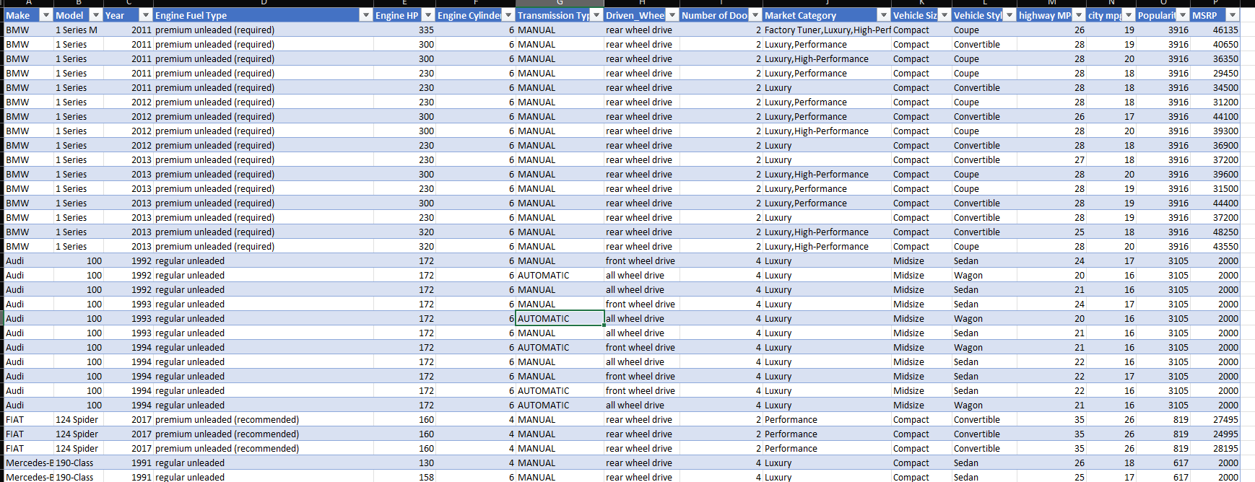
FOR TASK 1 FIRSTLY WE SEPERATED THE DATA IN COLUMN “MARKET CATEGORY” INTO DIFFERENT ROWS USING FOLLOWING
STEPS:- SELECT YOUR DATASET IN EXCEL ->GO TO THE DATA TAB AND CHOOSE GET & TRANSFORM -> FROM TABLE/ RANGE. ENSURE YOUR DATASET IS IN TABLE FORMAT.->SPLIT THE "MARKET CATEGORY" COLUMN ->IN POWER QUERY, SELECT THE MARKET CATEGORY COLUMN->GO TO THE HOME TAB AND CLICK SPLIT COLUMN ->CHOOSE THE DELIMITER (E.G., COMMA) AND SELECT SPLIT INTO ROWS->THE VALUES IN OTHER COLUMNS WILL AUTOMATICALLY REPLICATE FOR EACH SPLIT ROW->CLICK CLOSE & LOAD TO RETURN THE TRANSFORMED DATASET TO EXCEL.

Slide 22
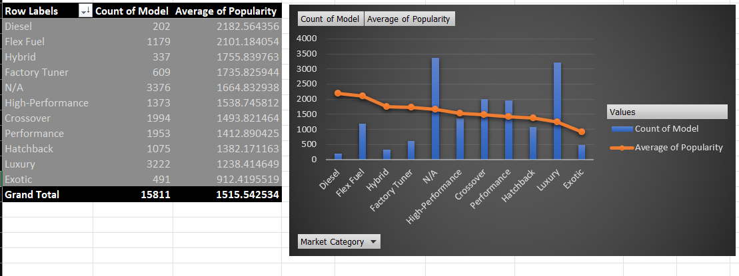
INSIGHTS:- THE DATASET HAS MOST NUMBER OF LUXURY CARS FOLLOWED BY CROSSOVER AND PERFORMANCE. THE AVERAGE POPULARITY RANGES BETWEEN 2200 AND 1200 EXCEPT FOR EXOTIC CARS WITH DIESEL CARS BEING THE MOST POPULAR AND EXOTIC , LUXURY BEING LEAST POPULAR

Slide 23
Task 2: Create a scatter chart that plots engine power on the x-axis and price on the y-axis. Add a trendline to the chart to visualize the relationship between these variables. Insight Required: What is the relationship between a car's engine power and its price?

Slide 24
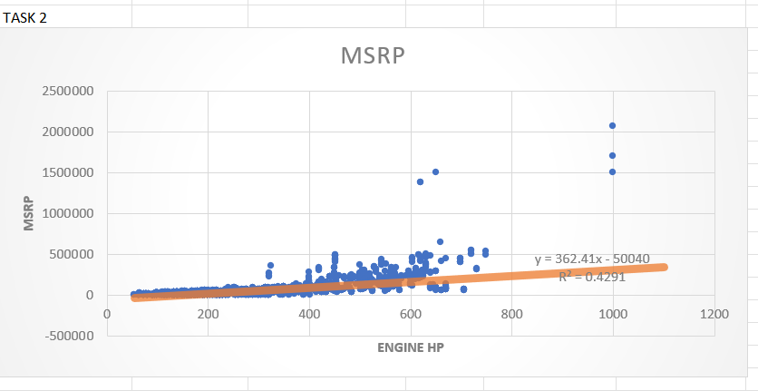
We can observe that the relationship is positive as the trendline has positive slope. This is logical as higher Engine HP requires more complex level of design and engineering and more expensive sub-parts.

Slide 25
Task 3: Use regression analysis to identify the variables that have the strongest relationship with a car's price. Then create a bar chart that shows the coefficient values for each variable to visualize their relative importance. Insight Required: Which car features are most important in determining a car's price?

Slide 26
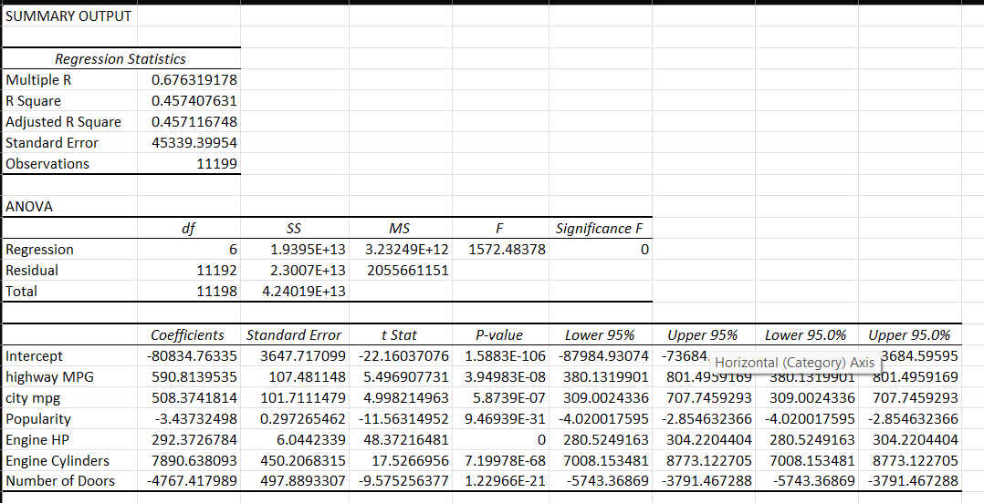

Slide 27
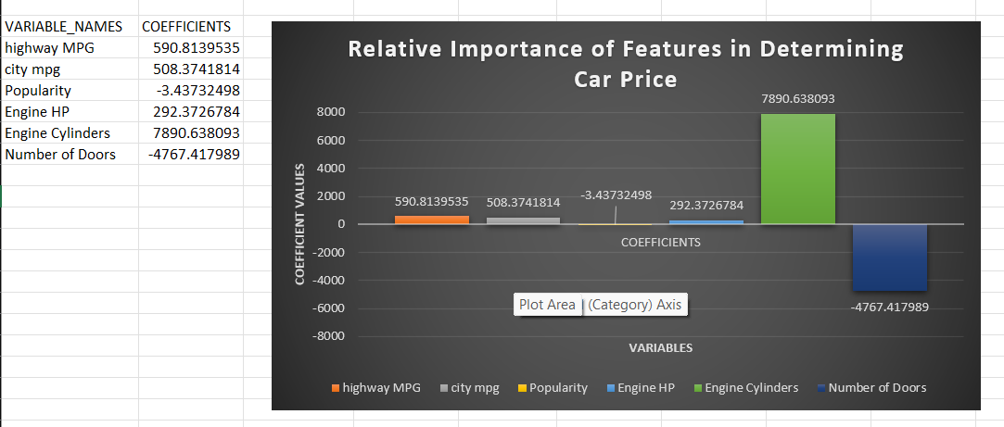

Slide 28
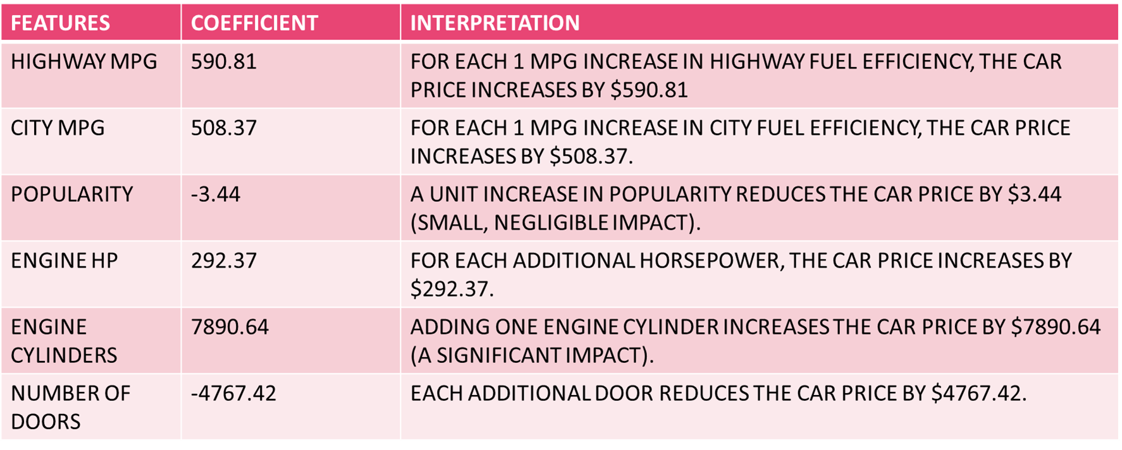
Engine Cylinders has the largest positive impact on price, with a significant increase of $7890.64 per additional cylinder . highway MPG and city mpg also positively influence price, indicating fuel efficiency is valued but less impactful than cylinders. Number of Doors decreases the price significantly by $4767.42 per additional door. This could indicate that models with fewer doors (e.g., coupes) are perceived as premium. Popularity has a very small negative coefficient (-3.44), indicating it has an almost negligible effect on car prices.

Slide 29
Task 4.A: Create a pivot table that shows the average price of cars for each manufacturer. Task 4.B: Create a bar chart or a horizontal stacked bar chart that visualizes the relationship between manufacturer and average price. Insight Required: How does the average price of a car vary across different manufacturers?

Slide 30
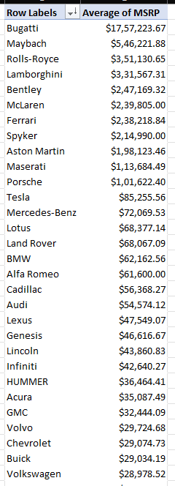
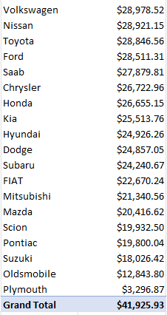
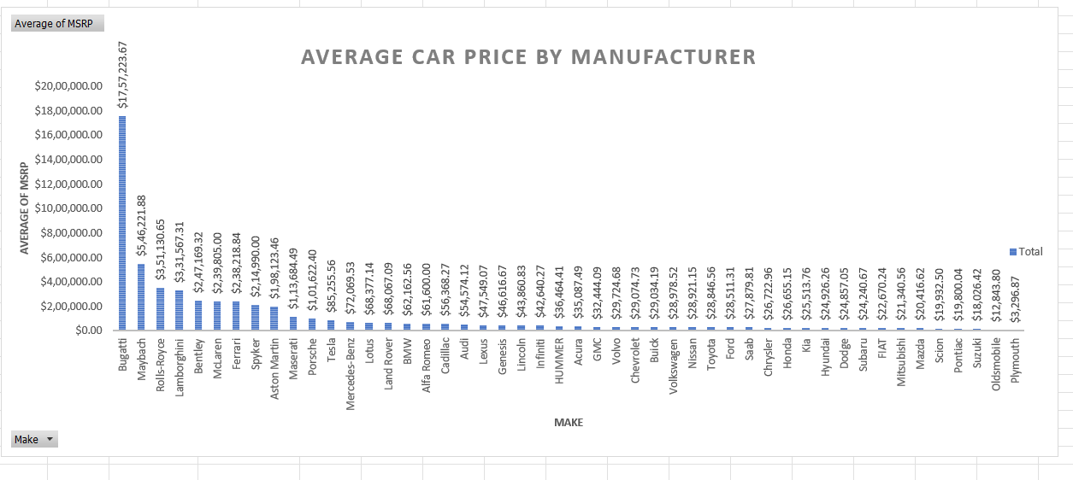
Ultra-Luxury Brands Dominate the Top: Brands like Bugatti and Maybach showcase the significant impact of exclusivity and brand value on car prices. Electric Luxury: Tesla's position highlights the rising importance of electric vehicles in the luxury segment. Mass Appeal in Mid-Range: Toyota, Honda, and Ford lead the mainstream segment, balancing affordability and quality. Brand Legacy: Premium brands (e.g., Mercedes-Benz, BMW) maintain consistent pricing, reflecting their historical position in the luxury market. Wide Price Variation: The car market shows substantial price variation across manufacturers, influenced by brand positioning, target audience, and production scale.

Slide 31
Task 5.A: Create a scatter plot with the number of cylinders on the x-axis and highway MPG on the y-axis. Then create a trendline on the scatter plot to visually estimate the slope of the relationship and assess its significance. Task 5.B: Calculate the correlation coefficient between the number of cylinders and highway MPG to quantify the strength and direction of the relationship. Insight Required: What is the relationship between fuel efficiency and the number of cylinders in a car's engine?

Slide 32
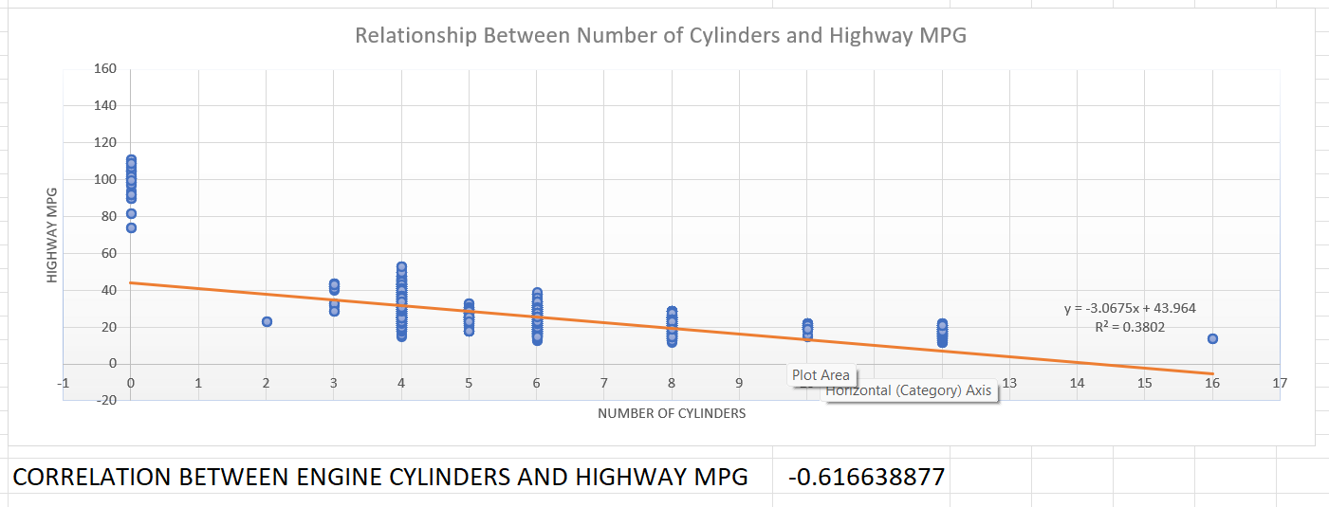
We can observe that the plot between highway MPG and Engine Cylinders has a negative slope with a value of -3.0675. The correlation coefficient is also Negative with a value of -0.61663887. This is logical because as number of Engine Cylinders increases, the amount of fuel to be burnt also increasing, thus decreasing the mileage (highway MPG)

Slide 33
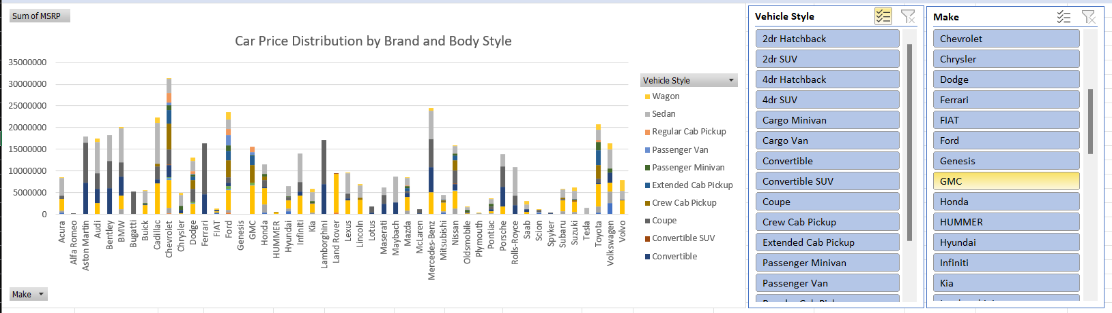
DASHBOARD 1: How does the distribution of car prices vary by brand and body style?

Slide 34
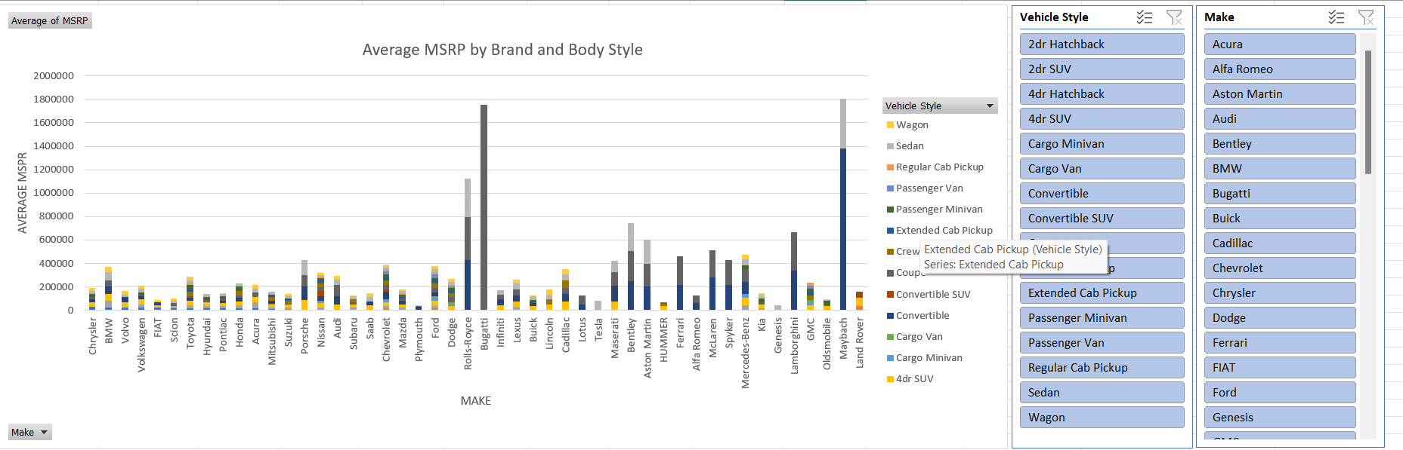
DASHBOARD 2: Which car brands have the highest and lowest average MSRPs, and how does this vary by body style?

Slide 35
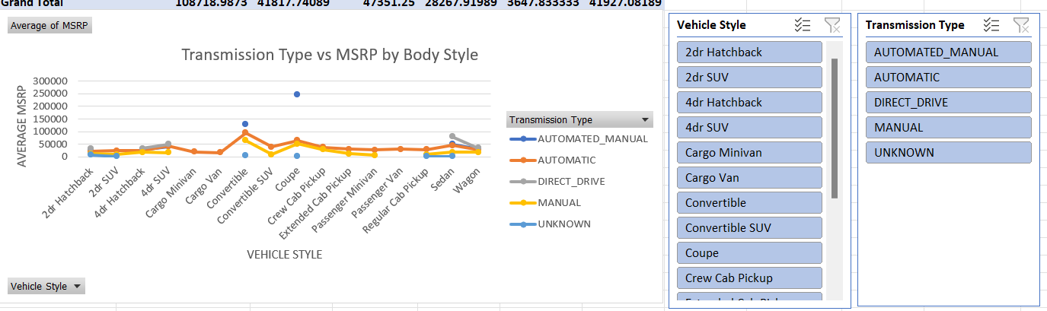
DASHBOARD 3: How do the different feature such as transmission type affect the MSRP, and how does this vary by body style?

Slide 36
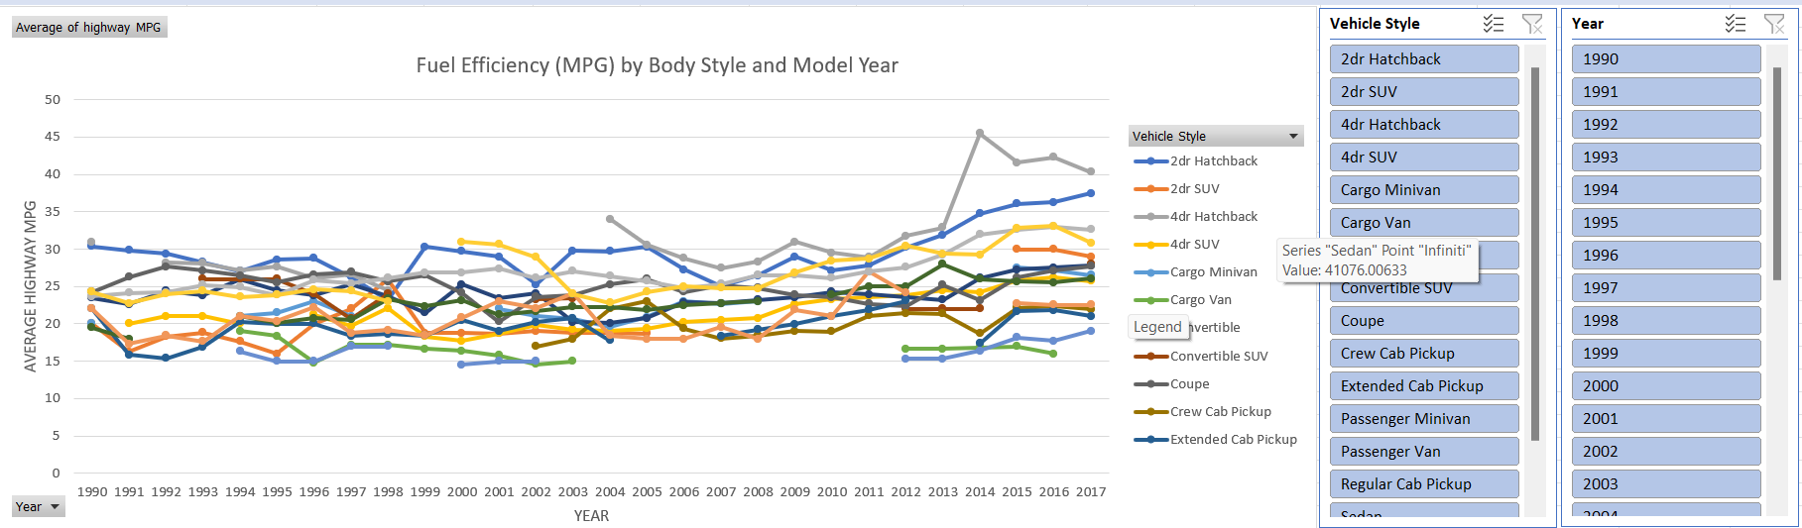
DASHBOARD 4: How does the fuel efficiency of cars vary across different body styles and model years?

Slide 37
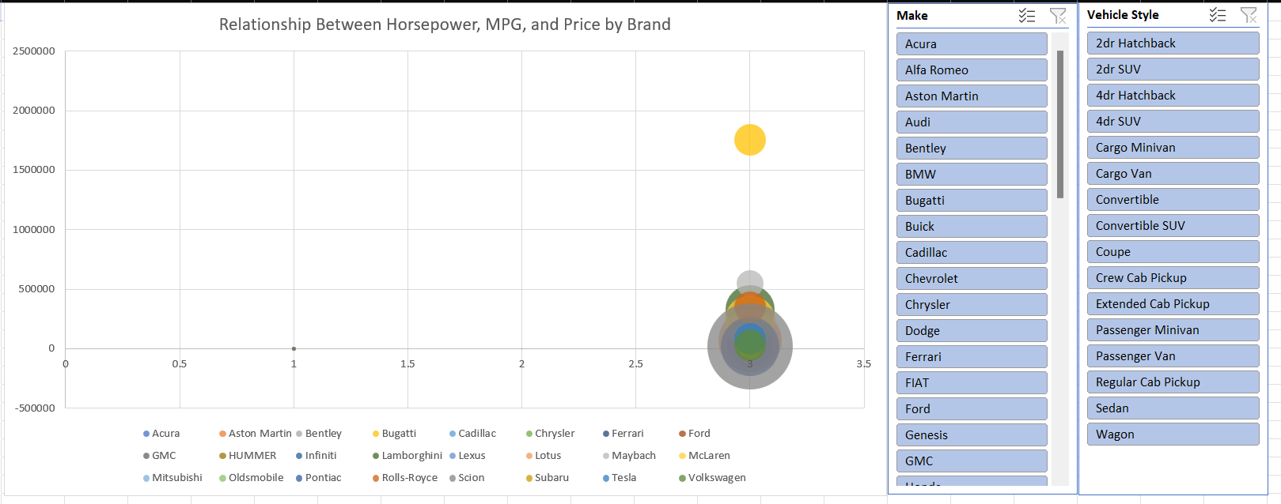
DASHBOARD 5: How does the car's horsepower, MPG, and price vary across different Brands?

Slide 38
CONCLUSION
THROUGH THIS PROJECT, I WAS ABLE TO UNDERSTAND THE IMPORTANCE OF DATA ANALYTICS IN CAR FEATURE ANALYSIS AS IT PROVIDES VALUABLE INSIGHTS WHICH HELPS IN MAKING DATA-DRIVEN DECISIONS.
IN THIS PROJECT I WAS ABLE TO GET INSIGHTS LIKE WHICH FEATURES EFFECTS CAR PRICE, RELATIONSHIP BETWEEN ENGINE CYLINDERS AND IT’S FUEL EFFICIENCY ETC. I ALSO GOT EXPERIENCE IN DATA PREPROCESSING LIKE DATA CLEANING, HANDLING OUTLIERS, FEATURE ENGINEERING ETC. IN THIS PROJECT WHICH CAN BE COMMUNICATED TO RELEVANT STAKEHOLDERS AS PER THE REQUIREMENTS.
LINK FOR EXCEL SHEET
https://docs.google.com/spreadsheets/d/1f5hSdrjMvuAQKxG2b1pz4qvkQ90iTbEk/edit?usp=drive_link&ouid=114522139830880122868&rtpof=true&sd=true

Slide 39

Thank You!
PRACHI SHINDE

